Slide 1
Obtaining Packet Traces
July 8, 2019

Slide 2
General Steps
Download malware samples
Filter samples to get legitimate malware
Submit samples to sandboxes
Download pcap files from sandbox analyses

Slide 3
Obtaining and Filtering Samples

Slide 4
Obtaining Samples
https://malshare.com/
With an API key, downloaded ~1300 samples
https://virusshare.com/
Now have access, but is much harder to get samples
Have to download huge files of malware (each is >8 GB)
Not all samples will be actual malware; need to filter to be sure that a sample is malware

Slide 5
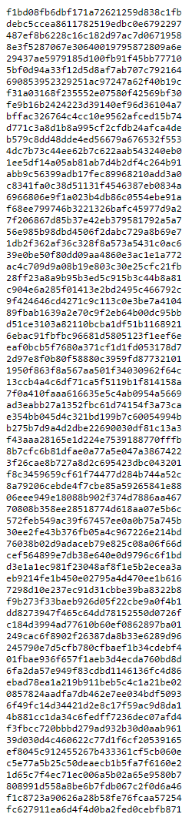
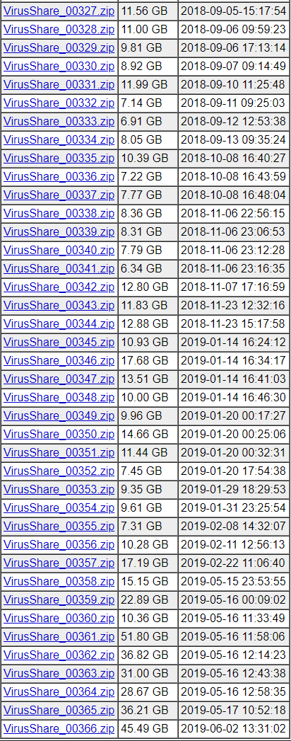
MalShare and VirusShare
MalShare’s Daily Digest. Each hash can be downloaded individually or the entire day can be downloaded
VirusShare downloads. File sizes are huge and there is not an option to download a specific number of samples

Slide 6
Filtering Samples
Use VirusTotal to filter samples
Submit a hash and get a report
Each report contains the results of ~40 anti-virus scans
Keep malware samples that are detected by >50% of anti-virus scans
If a hash is not in VirusTotal’s database, submit the file
Helps ensure that malware samples submitted to a sandbox are legitimate malwares
Cons
Limited to 4 API requests per minute

Slide 7
Obtaining Packet Traces

Slide 8
Approaches Tried
DETERLab
MalwareML
FANTASM
Using INetSim to simulate Internet services
Using online sandboxes to run malware in contained environment
Hybrid Analysis
Cuckoo Sandbox
any.run

Slide 9
DETERLab

Slide 10
Overview
DETERLab allows users to create experiments within projects
Experiments are isolated clusters of nodes connected to one another with direct links or tied together in a LAN
An experiment’s topology is specified by its creator, giving a lot of flexibility with how a network is set up (including links, LANs, operating systems, network delays, etc.)
Each experiment is isolated from every other experiment
Each node in the experiment is accessible via DETER’s control network and SSH
Nodes in an experiment can have either static or dynamic IP configuration
Nodes in an experiment cannot access the Internet; special access can be requested, but anything malware related will generally not be approved

Slide 11
MalwareML
Isolated testbed network for running malware
Pros:
Isolated network
Malware samples not stored on personal machine
Topology, routing, etc. are customizable
Cons:
Booting Windows nodes is slow (~15 minutes)
Have to reset Windows nodes after every malware sample
No Internet access: true malware behavior is hard to capture
No automatic pcap capture mechanism
Have to manage 2+ nodes and perform multiple captures

Slide 12
FANTASM
ISI project from 2017 that aims to capture real malware traffic
https://www.usenix.org/conference/laser2017/presentation/deng
Pros:
Both simulated services and ability to send http/https traffic to internet. Criteria for sending:
DNS, HTTP, or HTTPS
Cannot fake the reply
Obtain additional malware files, report data to bot master, receive commands
Must be unpredictable (NOT FTP, SMTP, or ICMP)
Suspicious flows are automatically stopped (ex. Traffic that could be used for scanning or DDoS; no replies from internet; TCP SYN with no ACK response; DNS with no reply)
No time limit for captures
Malware can receive fake executables from simulated service: prevents further infection
All impersonation services run on same machine (easier for capturing)

Slide 13
FANTASM (cont.)
Cons:
Multiple points of capture (simulated services and gateway): tougher to manage
Booting and resetting Windows nodes is still lengthy
Little support from DETERLab staff
When testing, simulated services did not behave correctly
Two network interfaces for each machine makes it difficult to capture traffic
Ex. Traffic that should go to the services instead goes over DETER’s control network (which may also represent a safety concern)
No way to automate analysis process (particularly with uploading samples)

Slide 14
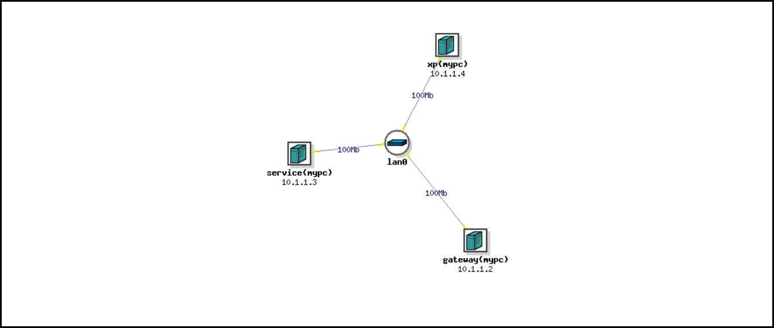
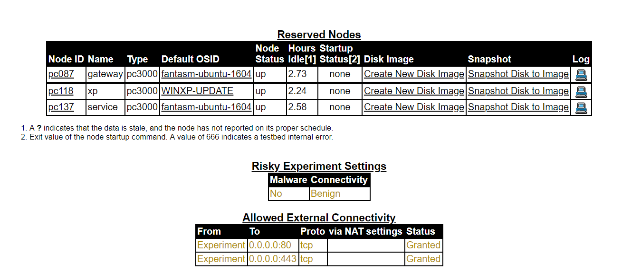
FANTASM (cont.)
FANTASM Topology
FANTASM Risk Access

Slide 15
Running an Internet Simulation
Looked into running an Internet simulator in one of our experiments
Best one I could find is INetSim (which is used by a number of sandboxes as well)
https://www.inetsim.org/
Pros:
Single point of capture for everything (all services hosted on one machine)
Ability to mimic Internet activity
No time limit for running malware
Cons:
Same problems as before: Windows taking a long time, no automation, two interface problems
Written in Perl: while Perl is installed on some DETER machines, it requires a lot of other libraries
All HTTP/S requests met with 404 errors: does not imitate malware behavior

Slide 16
Online Sandboxes

Slide 17
Overview
Sandboxes can be used to test untrusted or unverified programs in isolation from the host OS; any changes made to the virtual machine are NOT saved
From around 2009-2014 there were a lot of academic sandboxes available (Sandnet, Anubis, Truman, Norman, CWSandbox, etc.); however, most of these have been discontinued or have become proprietary services
There are many online sandboxes available; most are automated, meaning a user submits a file and it’s run without any interaction from the user
Online sandboxes generally allow three Internet access options:
Routing directly to the Internet (called a “dirty line”)
Routing via TOR
Using a fake Internet service (generally INetSim)

Slide 18
Overview (cont.)
There are a general set of pros in using online sandboxes:
Hosting, running, and routing are all outsourced to a dedicated service that can automatically minimize risks
Each is capable of capturing network traffic as well as a variety of OS system calls
Each produces its own analysis report
Software automatically identifies virus families (ex. Using YARA or cross-referencing the hash with anti-virus companies)
However, most online sandboxes are paid services, requiring subscription to access most features
I tried three online sandboxes, with mixed results:
Hybrid Analysis
Cuckoo Sandbox
any.run
For all of these sandboxes, any submissions become publicly available

Slide 19
Hybrid Analysis
Submit a file to an online interface and wait for automatic analysis
https://www.hybrid-analysis.com/
Pros:
Analysis is free
Process is automated
Has an API that can be used for batch submission/analysis
Can download pcap files
Cons:
References by hash: only one analysis allowed for each malware sample
Ex. I didn’t include a zip archive’s password at first. The analysis didn’t even start, but I can’t ever submit that sample again since it doesn’t allow overwriting that hash’s analysis
No interaction with virtual machines

Slide 20
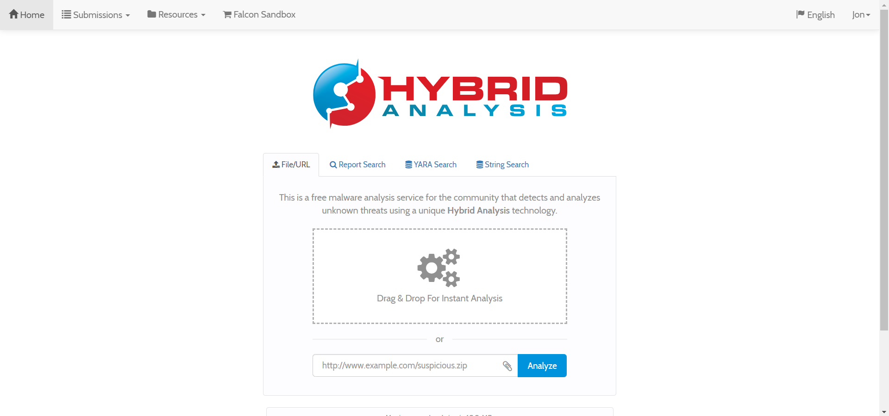
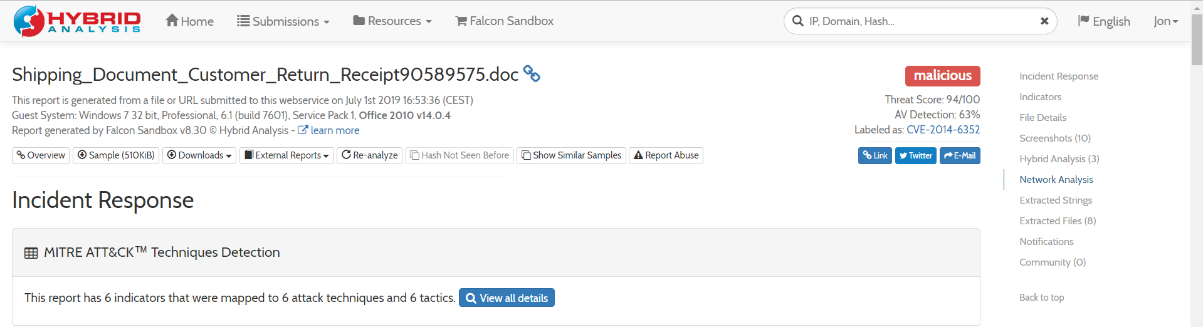
Hybrid Analysis (cont.)
Hybrid Analysis Homepage
Hybrid Analysis Report

Slide 21
Cuckoo Sandbox
Another automated analysis service; this one has both an online interface and a desktop client that you can download and run on a hosted virtual machine
https://cuckoo.cert.ee/dashboard/
Pros:
Analysis is free
Process is automated
Don’t need to install desktop client; can use web interface
Free download of analysis, pcap files
API to do batch analyses
Cons:
I found the desktop client hard to install: uses outdated Python libraries, requires you to supply own virtual machine
If hosted on own machines, doesn’t minimize contamination risks at all
Network report is not particularly useful: doesn’t do a good job of listing TCP or connections, reports everything as UDP
No interaction with virtual machines (except if you are running the desktop client)

Slide 22
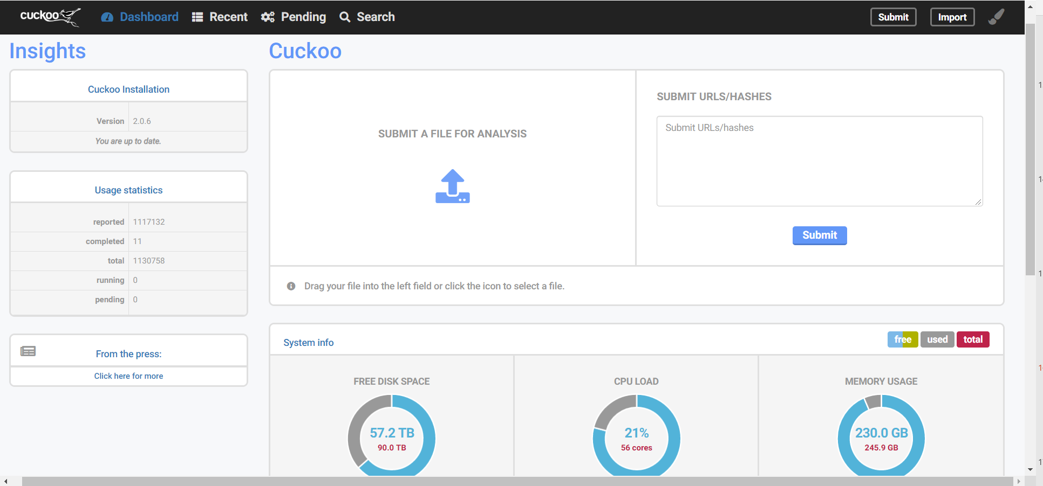
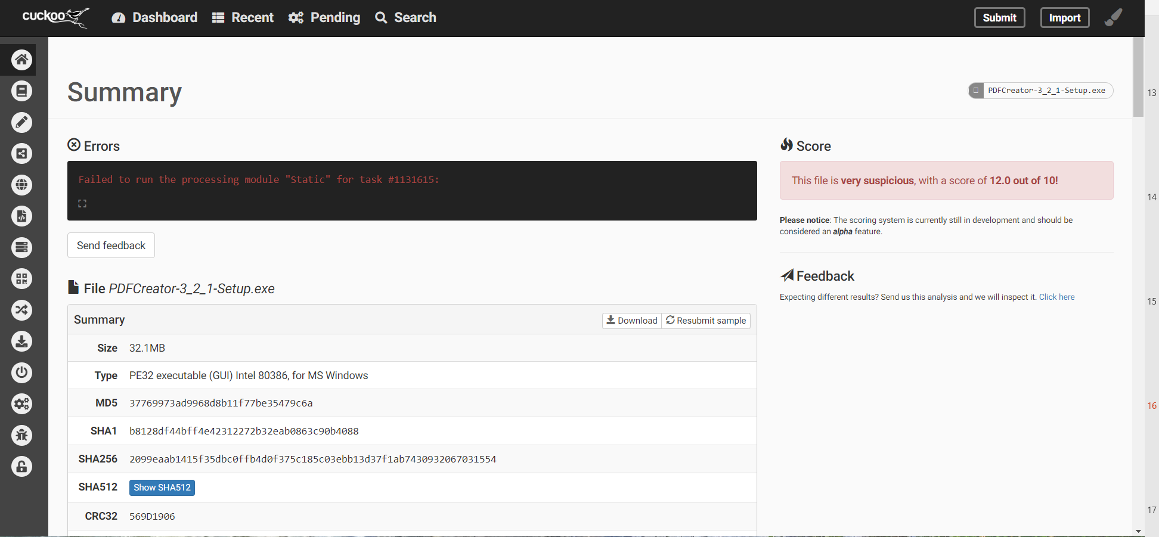
Cuckoo Sandbox (cont.)
Cuckoo Sandbox Homepage
Cuckoo Sandbox Analysis

Slide 23
any.run
Online sandbox service with both free and paid plans; unique in that it allows interaction with virtual machines
Is interaction necessary? If we have many samples, it won’t be feasible to interact with each one. Depends on number of malwares represented in dataset
Pros:
GUI for interacting with test machines
Both free and paid plans
Cons:
With free plan, all analyses become publicly available
Time limit of ~5 minutes
Can’t do batch analysis

Slide 24
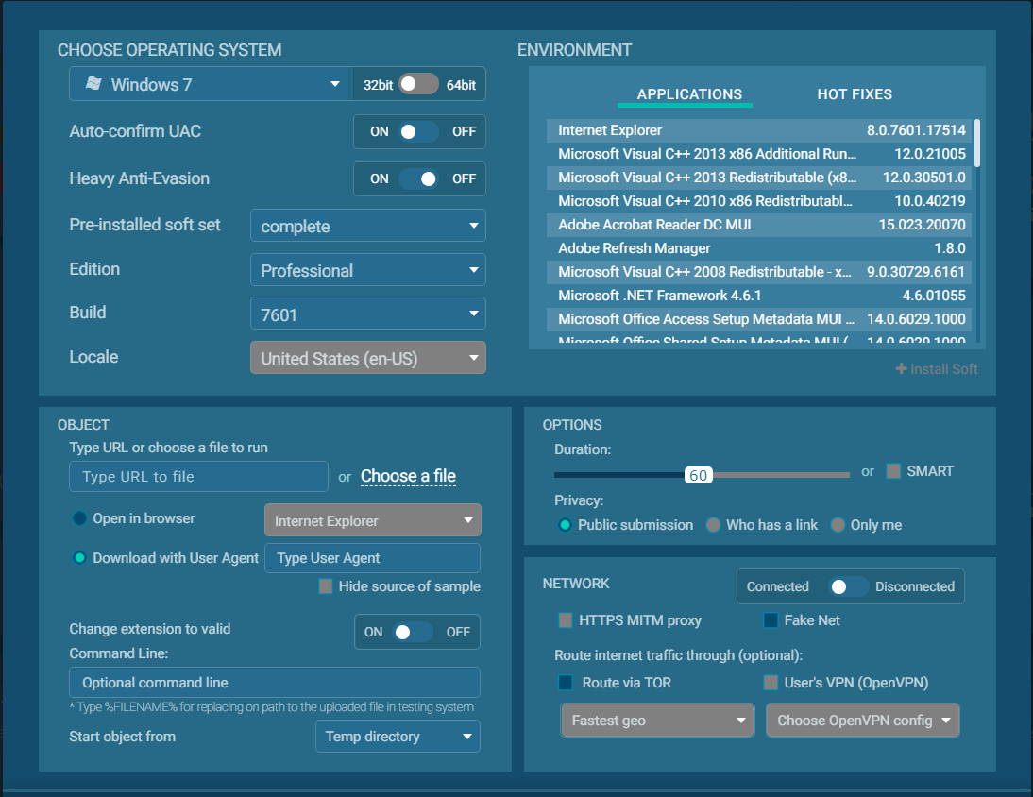
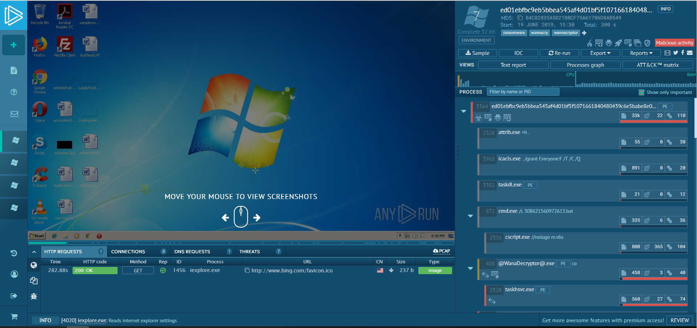
any.run (cont.)
any.run analysis
any.run new task options

Slide 25
General Info

Slide 26
General Problems with capturing network traffic
Some malware can tell if it’s being run in a virtual environment (ex. by checking disk space or system name); it if thinks that it is, it doesn’t run properly
To get truly accurate results, have to let malware run for extended periods of time (activity is often cyclical)
Most papers/generated datasets stick to 5 minutes per sample, both because some samples don’t generate interesting traffic and the sheer number of samples that must be analyzed
Some malware tries to contact servers that have been targeted by takedown efforts: will not get many responses

Slide 27
General Problems with capturing network traffic (cont.)
Ransomware either doesn’t generate packets (tcp, dns, etc.) or contacts servers directly (harder to capture)
Have to classify malware into families for reproducibility
Testing on multiple OS for realistic results
Generating benign/background traffic can be difficult
Most papers use existing datasets for this purpose
Even with internet access and running only malware, there is background noise that requires labelling (ex. ARP queries)
Using honeypots: have to redirect some traffic to avoid further infection, download of other malwares, and use of your machine/IP for attacks
Can easily get your IP blacklisted

Slide 28
Other things to consider
Classifying malware samples to obtain ground-truth labels (ex. worm, trojan, ransomware, etc. or specific families)
Malware families are hard to identify, since each anti-virus service gives different labels
VirusTotal: submit a file or hash and view analysis results from ~40 antivirus companies; can be used to get/generate labels
Has own API to submit hashes or files
Number of malware samples analyzed (most experiments collect ~20000 samples, then take a random sample and test)
Some “malware” can also be benign; need to verify
Can use shadowserver’s bintest to submit potential malicious files and check with whitelist of benign software
any.run would not be useful here, since there is no way to do batch analysis
Where to get malware samples?
Github repo theZoo
https://virusshare.com/
Must request access from admins
https://malshare.com/
With an API key, can download up to 1000 samples per day

Slide 29
Papers
Prudent Practices for Designing Malware Experiments: Status Quo and Outlook
10.1109/SP.2012.14
Sandnet: Network Traffic Analysis of Malicious Software
https://www.cs.vu.nl/~herbertb/papers/sandnet_badgers2011.pdf
An Empirical Comparison of Botnet Detection Methods
10.1016/j.cose.2014.05.011
Understanding Malware’s Network Behaviors using Fantasm
https://www.usenix.org/conference/laser2017/presentation/deng

Slide 30
Next Steps
Continue filtering samples
Submit samples to sandboxes
Hybrid Analysis: has an API for easier, automatic submission
Any.run: interactive
See which sandbox gives better pcap files

Slide 31
Filtering Observations

Slide 32
Tons of HTML Files
Many of the files downloaded from MalShare were actually html files; they are essentially worthless in a sandbox
This is a common theme in sandboxes: they allow URL submissions
Looks like MalShare has a lot of these links/html files instead of actual binaries

Slide 33
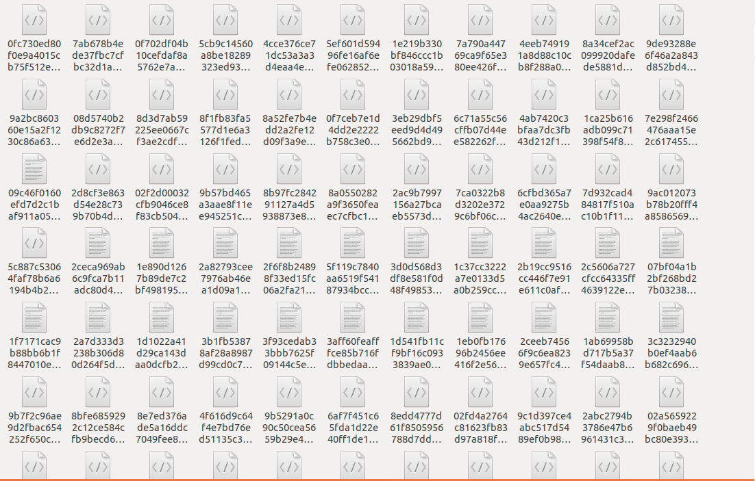
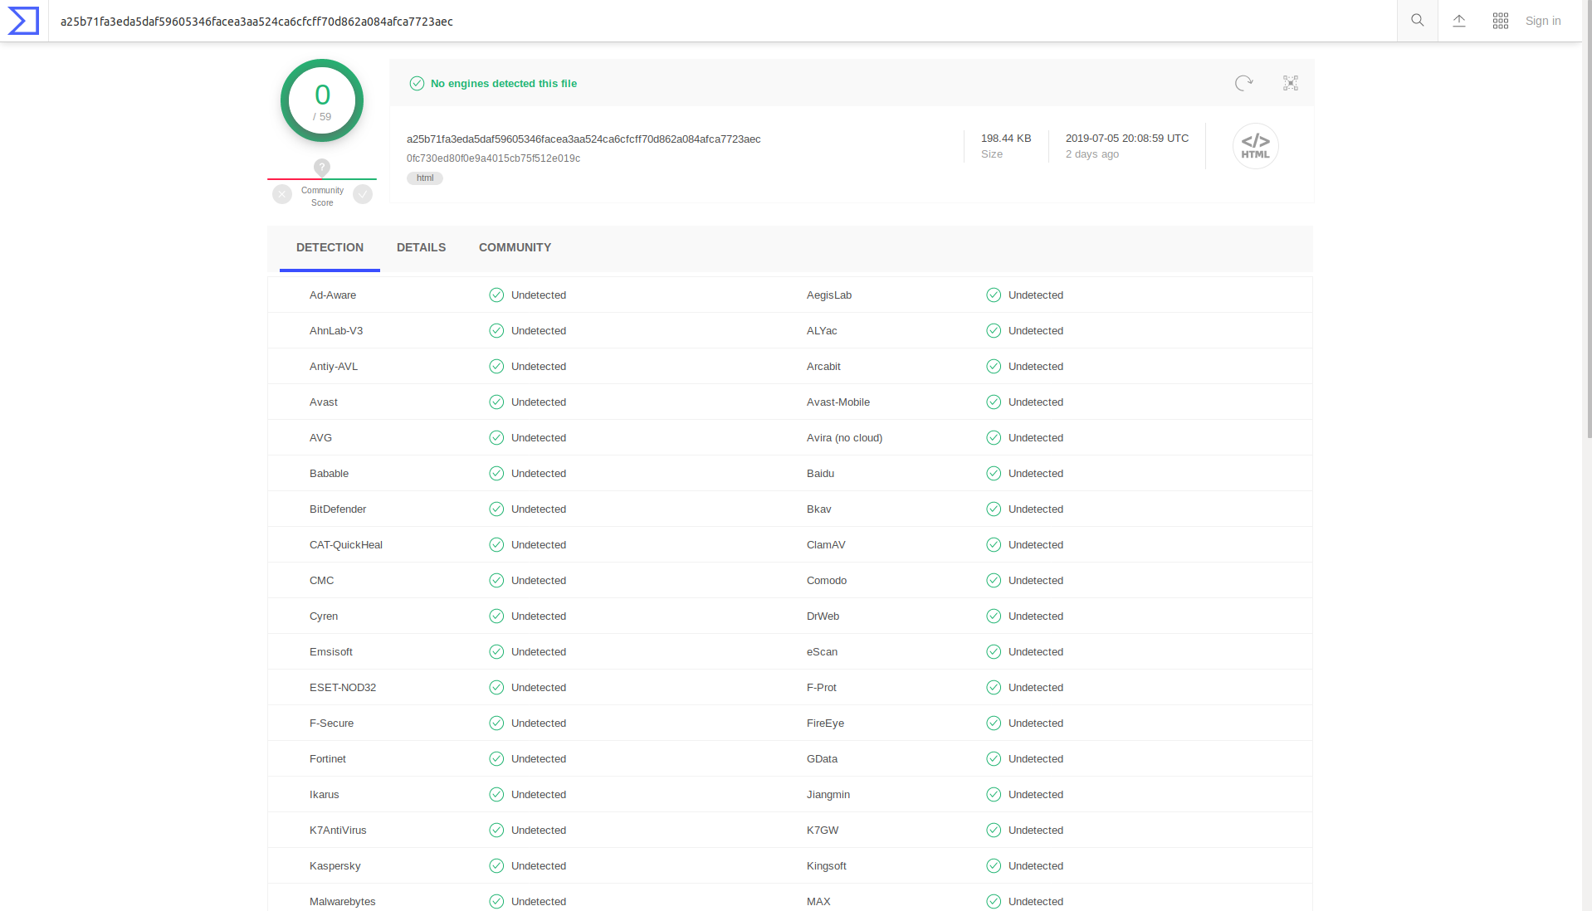
Files that VirusTotal doesn’t think are malware
Look at all the html files!
HTML files, understandably, aren’t detected by any anti-virus

Slide 34
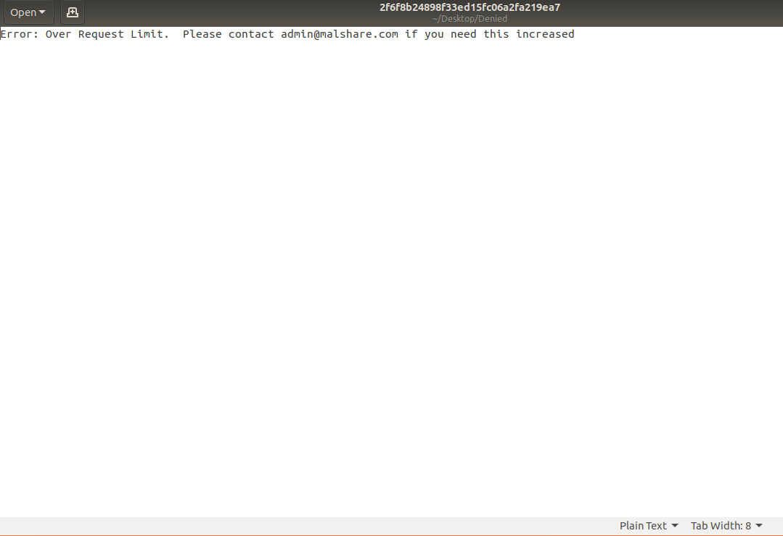
Mistakes when downloading samples
The daily limit for sample downloads from MalShare is 1000
I downloaded 1300 in one day, so 300 files are not valid
When hashing samples, it appears that a bunch have the same hash (and/or their hash doesn’t match the download name): this is because they are all the same error message
Instead, there are 300 text files that slow down the filtering process and aren’t useful

Slide 35
Denied File Trends
Finally, many of the malware samples are Linux-specific malwares
Most of the antivirus represented by VirusTotal are Windows-specific, so these malwares have a bias against them
Running Linux malwares would also be fairly complex in sandboxes, since most use Windows machines
Backdoors and Bitcoin miners are also not well represented by VirusTotal
There are a high number of antivirus identifying as malware, but not over the 50% threshold

Slide 36
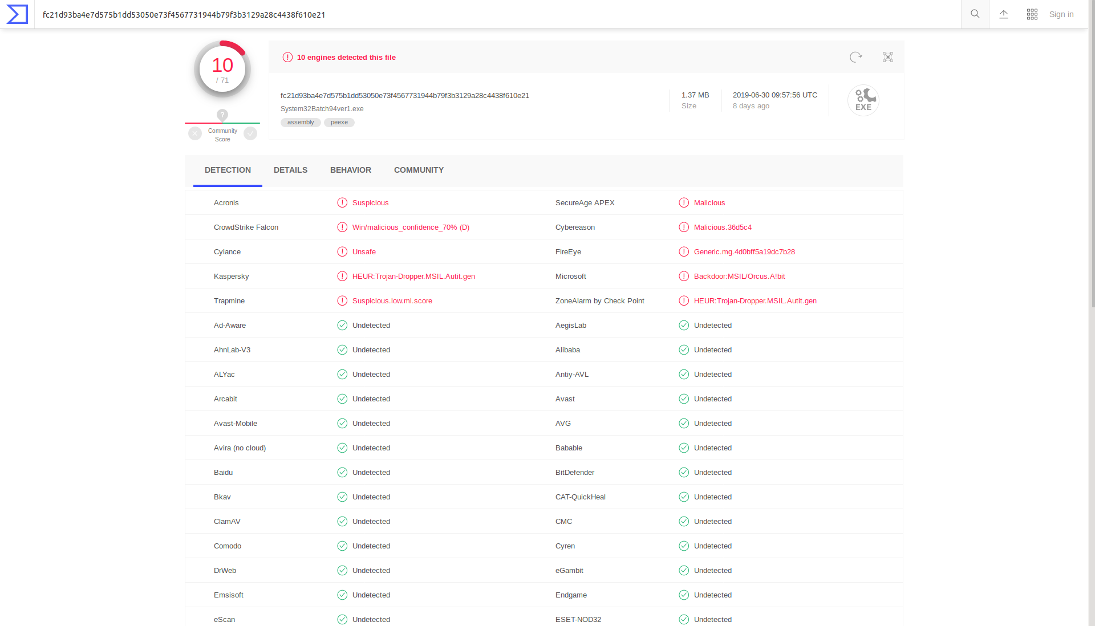
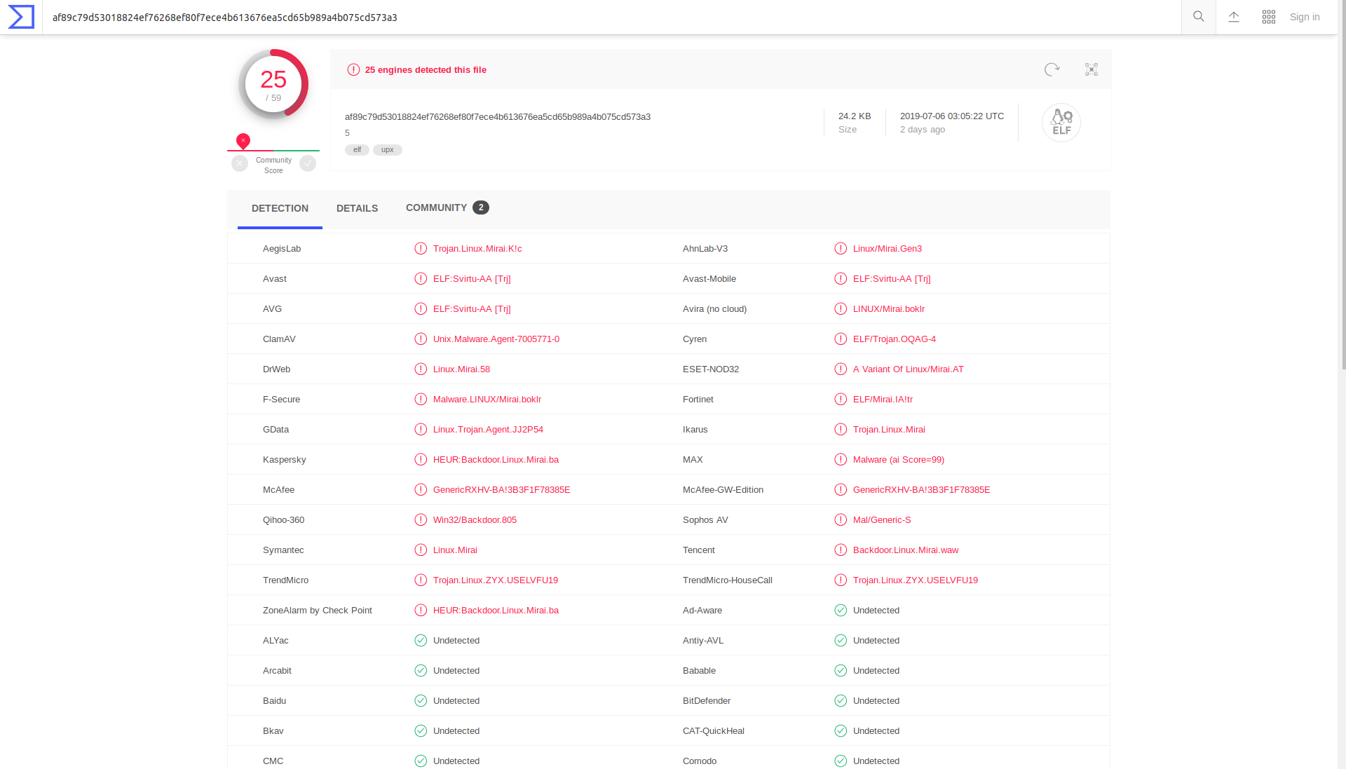
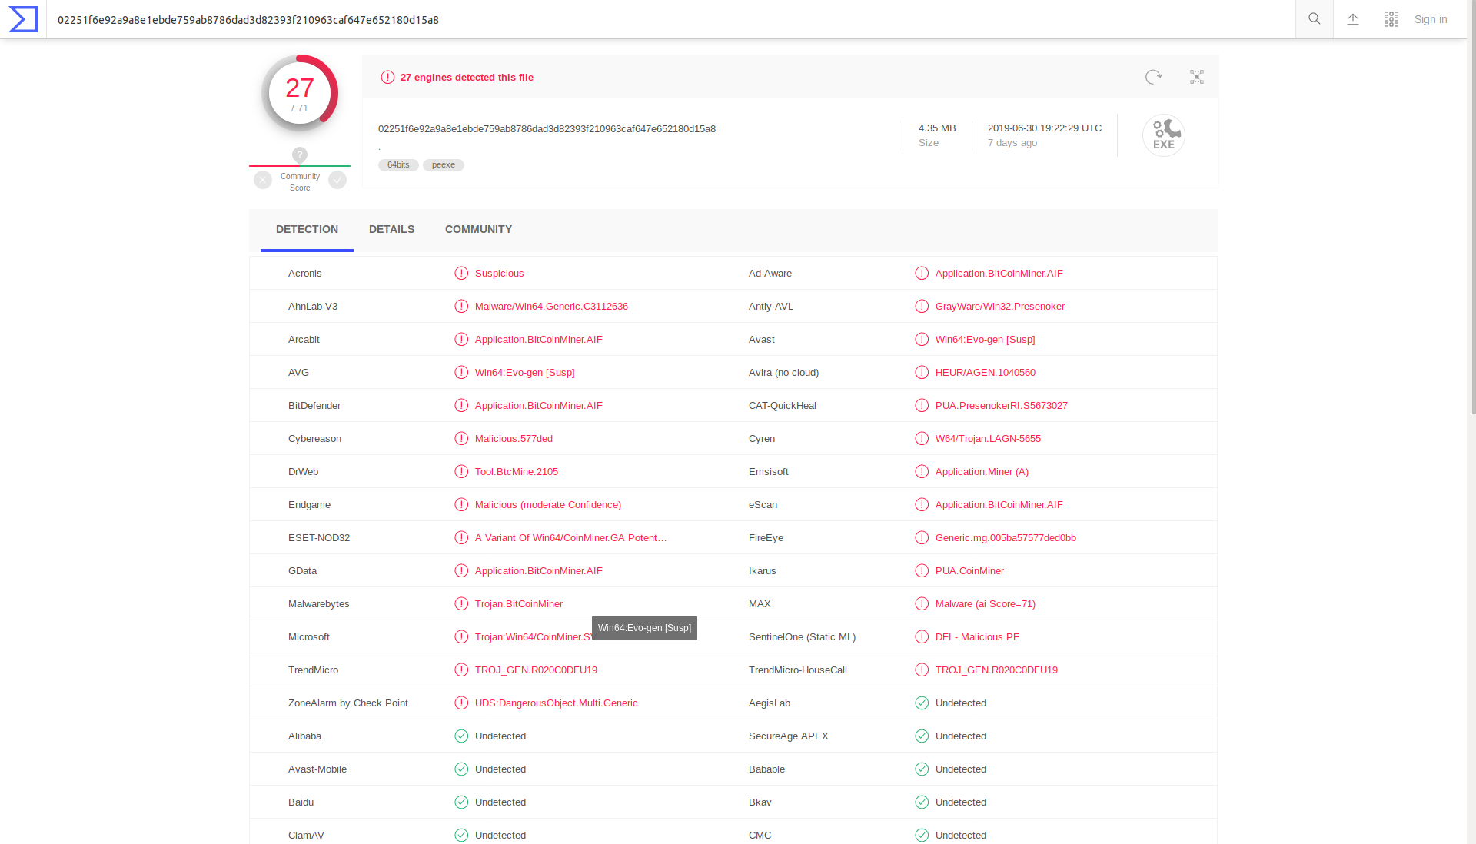
Denied malware examples

Slide 37
any.run pcaps

Slide 38
Some files don’t generate network activity
Many of the files that made it past the filtering stage don’t generate any network activity
Instead, most of these files make changes to the Windows registry or perform other system-related procedures
If there was no traffic generated within 1 minute, I stopped the analysis
Almost all were accurately identified as malicious

Slide 39
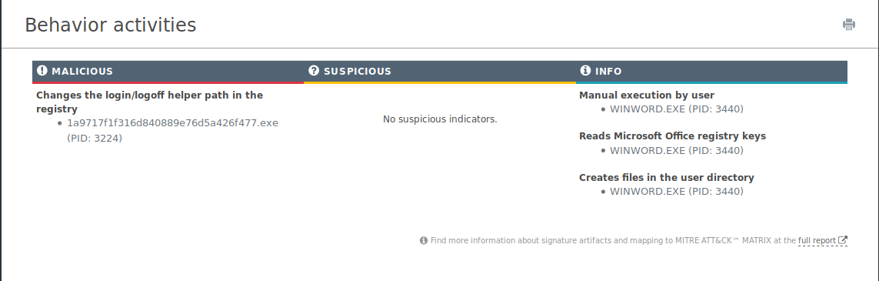
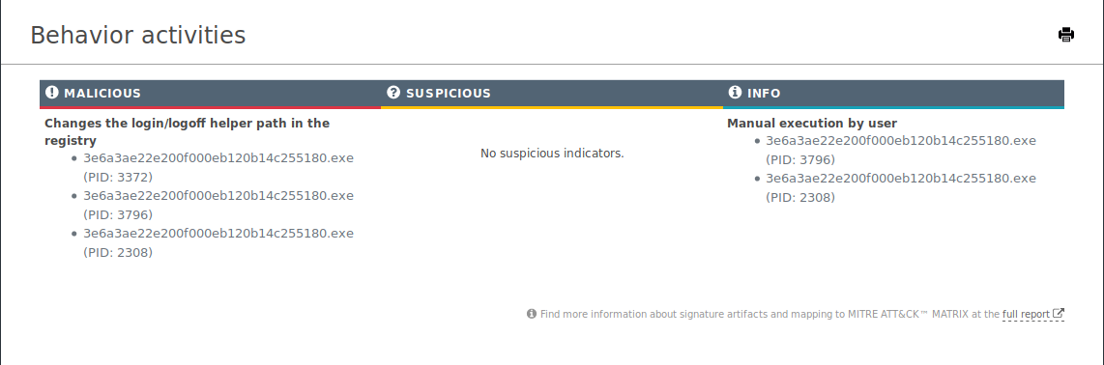
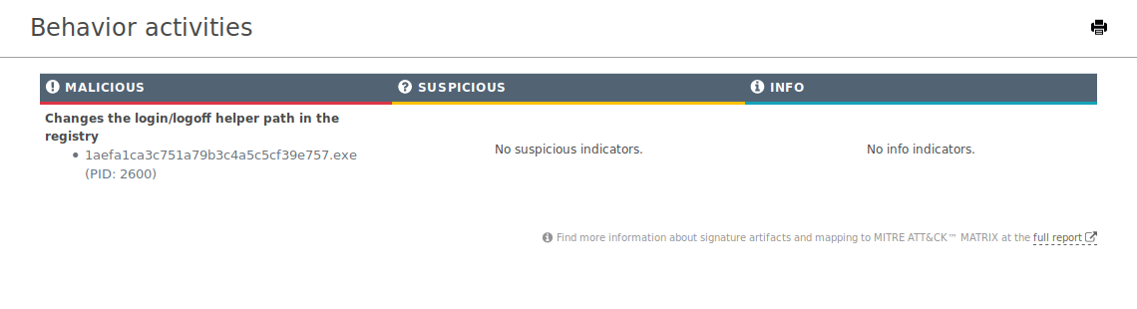
No network activity

Slide 40
Some files don’t run
Some files don’t run, even though they passed the filtering stage
Most of these files have no extension, and so the extension must be inferred
Most of the time, the inferred extension is .o
.o files aren’t run, and so nothing comes of the analysis

Slide 41
Network activity
Some files, however, do generate network traffic
If it was generated within 1 minute, I let the analysis run for 4 more minutes (total 5 minutes)
The pcap files are posted on github
I can provide report details if need be
Some file types are interesting: excel files, for example
Each file’s md5 hash is used as its name

Slide 42
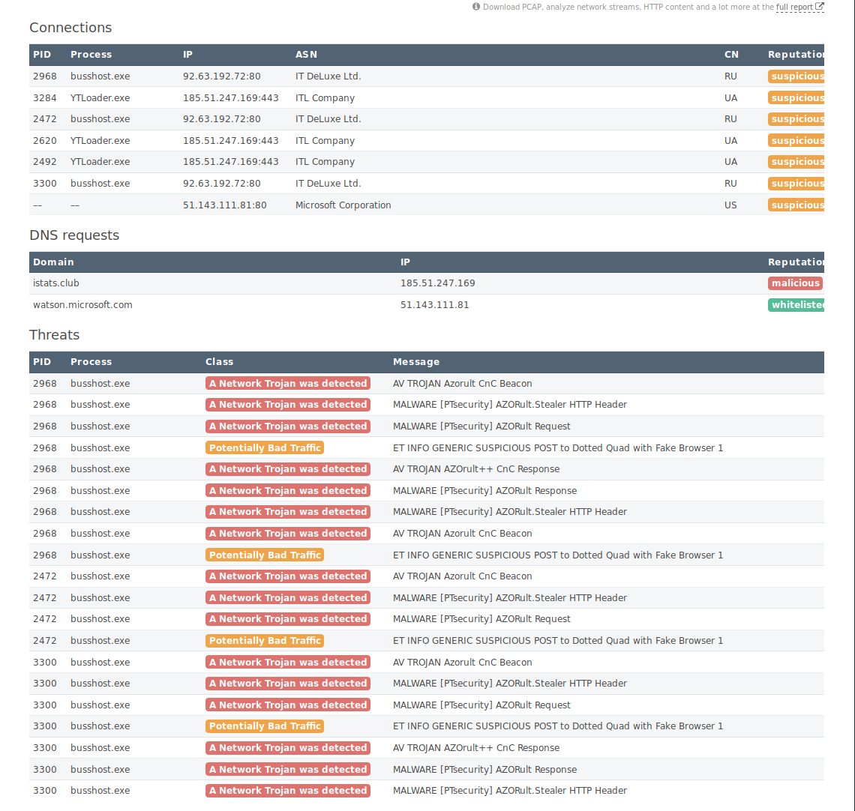
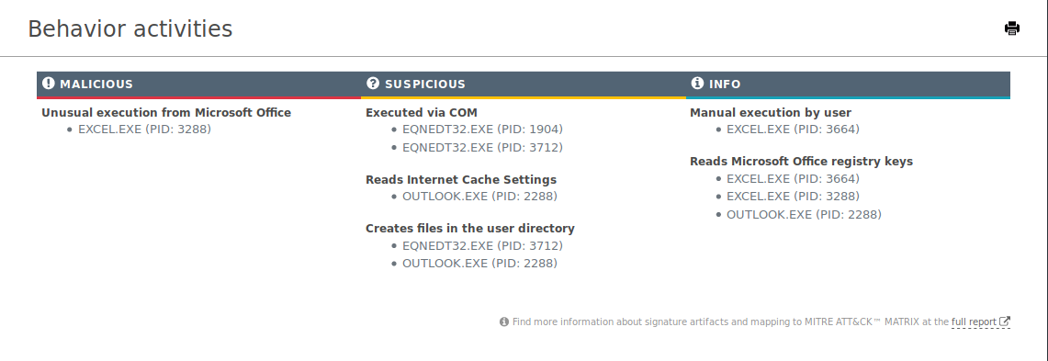
Network activity

